Slide 1
Seeing Versus Reading is Believing: A Reliability Study of Sample Manipulation
Travis Sain
Rachel Swiatek
Chad E. Drake, PhD

Slide 2
Reliability of the IRAP
Reliability of the IRAP appears inconsistent, with test-retest and internal consistency estimates across IRAP studies tending to fall outside of the acceptable range (Golijani-Moghaddam, Hart, & Dawson, 2013)
Changes in IRAP procedures have led to increases in the internal consistency
E.g., changing from 3000ms to 2000ms criterion improves internal consistency from .44 to .81 (Golijani-Moghaddam et al., 2013)
Test-retest reliability has tended to approach .50, and has proved more difficult to improve upon as the stability of the IRAP depends on the internal consistency as well
Question: what else can researchers do in an attempt to
increase the reliability of the IRAP?

Slide 3
Text vs. Image Stimuli in the IRAP
Text-based sample stimuli tend to dominate IRAP research (e.g., Barnes-Holmes, Hayden, Barnes-Holmes, & Stewart, 2008; Cullen, Barnes-Holmes, Barnes-Holmes, & Stewart, 2009)
Image-based stimuli have been utilized in previous research with good success (e.g., Barnes-Holmes, Murtagh, Barnes-Holmes, & Stewart, 2010; Nolan, Murphy, & Barnes-Holmes, 2013)
To date, no direct comparison of different forms of sample stimuli has appeared in IRAP literature
The current study: text-based vs. image-based IRAP for two historical figures (Abraham Lincoln and Adolf Hitler)

Slide 4
Method
Informed consent
Complete self-report measures*
Demographics
Semantic differential scale (SDS)
Explicit ratings of Abraham Lincoln and Adolf Hitler
Complete 3 identical IRAPs* with either text- or image-based sample stimuli
Below 2000 ms
Above 78% accuracy
Debriefing
*Self-report measures and IRAPs were counterbalanced

Slide 5
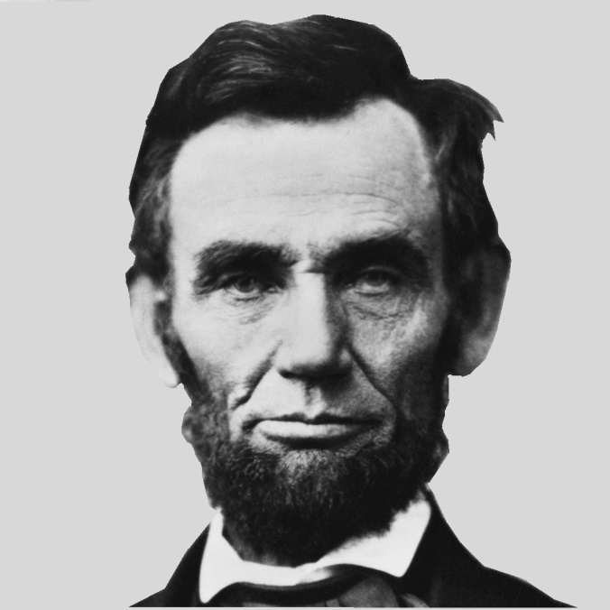
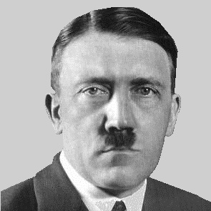
Sample Stimuli
Abraham Lincoln Adolf Hitler

Slide 6
Target Stimuli
Positive Words | Negative Words
Caring | Bad
Friend | Cruel
Good | Dangerous
Nice | Enemy
Safe | Hateful
Trustworthy | Selfish

Slide 7
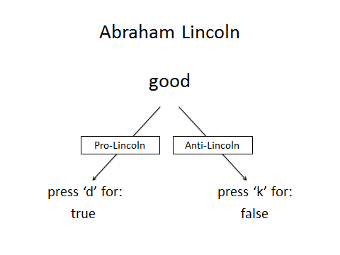
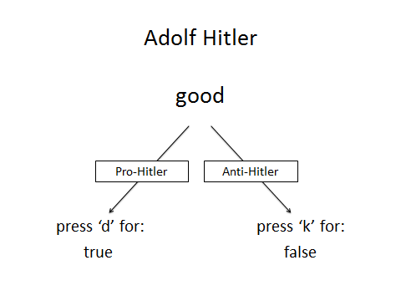
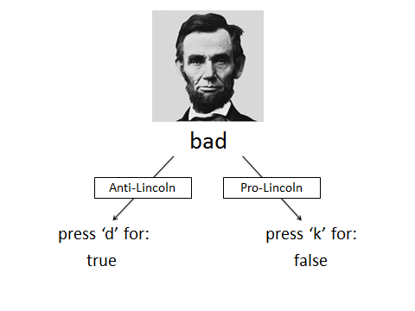
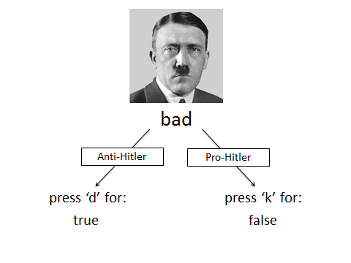

Slide 8
Sample Characteristics
N = 72 (36 per condition)
Average age of 19
74% freshmen, 18% sophomores, 8% juniors
65% Christian, 8% Agnostic, 7% Atheist, 6% Jewish, 11% Other
65% female, 35% male
47% Caucasian, 44% African-American, 4% Latino
Annual income: $25,000 or less- 32%; $25-$50,000- 32%; $50-$75,000- 18%; $75,000 or more- 18%

Slide 9
Measures
SDS
Rated each word from -5 (Extremely Negative) to +5 (Extremely Positive)
Average for each word in expected direction (lowest average had an absolute value of 2.86)
Average SDS total for all positive words = 3.79
Average SDS total for all negative words = -3.66
Explicit ratings of Lincoln and Hitler
Hitler/Lincoln was a good/bad person?
Rated from 1 (Strongly Disagree) to 7 (Strongly Agree)
Lincoln: good = 6.23, bad = 1.89
Hitler: good = 1.43, bad = 6.22
How positive/negative are your thoughts of Hitler/Lincoln?
Rated from 1 (not at all) to 11 (extremely)
Lincoln: positive = 9.26, negative = 2.19
Hitler: positive = 1.65, negative = 10.06

Slide 10
78% accuracy increases 8 of 15 effects displayed below
Results: Text IRAP D Scores
Averages for four trial-types and overall D scores
 | Lincoln Good | Lincoln Bad | Hitler Good | Hitler Bad | Overall D
IRAP 1 | .2799** .2771** .2967** | .2029** .2347** .2693** | -.0500 -.0747 -.0084 | .0717 .0120 .0069 | .1261** .1123* .1414**
IRAP 2 | .2789** .3089** .3563** | .3019** .2790** .2040* | -.0684 -.0829 -.0836 | .1099* .1443* .1106 | .1556** .1623** .1468**
IRAP 3 | .3314** .3407** .4364** | .1790** .1601* .1773* | -.0807 -.0925 -.1071 | .1487* .0966 .0054 | .1446** .1262** .1280*
All participants (n = 33) All IRAP 70% (n = 25) All IRAP 78% (n = 17)

Slide 11
Results: Text IRAP Cont.
Split-half reliability
 | Lincoln Good | Lincoln Bad | Hitler Good | Hitler Bad | Overall D
IRAP 1 | -.025 | -.397* | .306 | .463* | .267
IRAP 2 | -.060 | .011 | .162 | -.124 | .024
IRAP 3 | .117 | -.283 | -.066 | -.212 | .015

Slide 12
Results: Text IRAP Cont.
Test-retest reliability
 | Lincoln Good | Lincoln Bad | Hitler Good | Hitler Bad | Overall D
IRAP 1 with 2 | .079 | .062 | .049 | .127 | .117
IRAP 1 with 3 | -.047 | .031 | .309 | -.035 | -.024
IRAP 2 with 3 | .311 | -.172 | .058 | -.012 | .098

Slide 13
78% accuracy increases 7 of 15 effects displayed below
Results: Image IRAP D Scores
Averages for four trial-types and overall D scores
 | Lincoln Good | Lincoln Bad | Hitler Good | Hitler Bad | Overall D
IRAP 1 | .3354** .3585** .3264** | .2414** .2285** .2091* | -.2165** -.2168** -.2557* | .0455 .0057 .1218 | .1015** .0935* .1004
IRAP 2 | .5194** .5173** .4961** | .2547** .2727** .2573** | -.0283 -.0161 -.0295 | .2020** .1924* .2363* | .2369** .2416** .2401**
IRAP 3 | .4699** .4603** .4460** | .1208 .0335 -.0451 | -.0084 .0240 .0049 | .1618** .1831* .2111* | .1860** .1752** .1542*
All participants (n = 33) All IRAP 70% (n = 25) All IRAP 78% (n = 17)

Slide 14
Results: Image IRAP Cont.
Split-half reliability
 | Lincoln Good | Lincoln Bad | Hitler Good | Hitler Bad | Overall D
IRAP 1 | .228 | -.237 | .048 | .420* | .140
IRAP 2 | .061 | .159 | .066 | .299 | .231
IRAP 3 | .382* | .190 | -.239 | -.212 | .053

Slide 15
Results: Image IRAP Cont.
Test-retest reliability
 | Lincoln Good | Lincoln Bad | Hitler Good | Hitler Bad | Overall D
IRAP 1 with 2 | -.260 | .243 | .128 | .008 | -.337
IRAP 1 with 3 | .248 | .184 | .492* | .269 | .119
IRAP 2 with 3 | -.243 | .536** | .220 | .192 | .178

Slide 16
Comparison of Images and Text
No significant difference between conditions for:
Age, religion, sex, SES, or race
Average percent correct across all 3 IRAPs
All four trial-types and overall D across all 3 IRAPs (except 2nd Lincoln good)
SDS ratings of target stimuli
Explicit ratings of Lincoln and Hitler
Significant difference between conditions for:
Average median latency for each IRAP
Average median latency for consistent and inconsistent blocks for each IRAP

Slide 17
Comparison of Images and Text
Failed to meet PC during test blocks
70% Criteria
78% Criteria

Slide 18
Explicit/Implicit Correlations
Correlations of self-report attitudes with D scores
*No significant differences between conditions
1st IRAP | LincolnGood | LincolnBad | HitlerGood | HitlerBad | Overall D
HitlerAtt | .013 | .138 | -.271* | -.031 | -.074
LincolnAtt | .105 | .068 | .224 | .100 | .222
2nd IRAP | LincolnGood | LincolnBad | HitlerGood | HitlerBad | Overall D
HitlerAtt | .307** | -.070 | -.173 | -.078 | -.025
LincolnAtt | -.033 | .147 | .031 | .108 | .118
3rd IRAP | LincolnGood | LincolnBad | HitlerGood | HitlerBad | Overall D
HitlerAtt | .191 | .294** | -.180 | -.097 | .095
LincolnAtt | .119 | -.121 | .250* | .074 | .138

Slide 19
Discussion
In general, pictures as sample stimuli produced faster median latencies, larger trial-type and overall D scores, and slightly better split-half and test-retest reliability
Faster median latencies for image-based IRAP suggests that subjects found it easier to respond to stimuli when viewing a picture rather than text
A significant pro-Hitler effect was found on the Hitler-good trial-type for the first IRAP in the image condition, but this effect disappeared on subsequent IRAP administrations
Should IRAP researchers consider using images as sample stimuli more often?

Slide 20
Limitations
6 subjects failed to provide data on at a least 1 of the 3 IRAP iterations (1 in text and 5 in image condition)
As many as 15 subjects in either condition failed to meet percent accuracy (78%) criterion on one IRAP
Due to experimenter error, one subject’s first IRAP utilized incorrect sample stimuli
Repeated administrations of the IRAP occurred within 30 minutes- inconsistent with many IRAP studies looking at test-retest reliability
May allow moment-to-moment changes in attitudes towards Hitler and Lincoln affect IRAP reliability
Repeated administrations over several days or weeks may produce more reliable results

Slide 21
Thank you

